Slide 1
Flight Notification System

Slide 2
Technology used
Frontend Tech Stack:
1. React.js: A JavaScript library for building user interfaces.
2. Socket.IO-Client: For real-time communication with the backend via Web Sockets.
3. React Router: For client-side routing and navigation.
Backend Tech Stack:
1. Node.js: JavaScript runtime for building the server-side application.
2. Express: Web framework for Node.js. Fast, unopinionated, minimalist web framework for Node.js.
3. Nodemailer: Module for sending emails using SMTP.
4. Socket.IO: Library for real-time web applications, enabling real-time, bidirectional communication between web clients and servers.

Slide 3
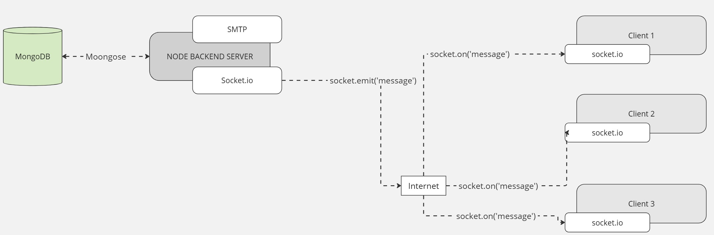
Connection Establishment

Slide 4
Connection flowchart

Slide 5

Working Of SERVER CLIENT
How actually we are achieving this.

Slide 6
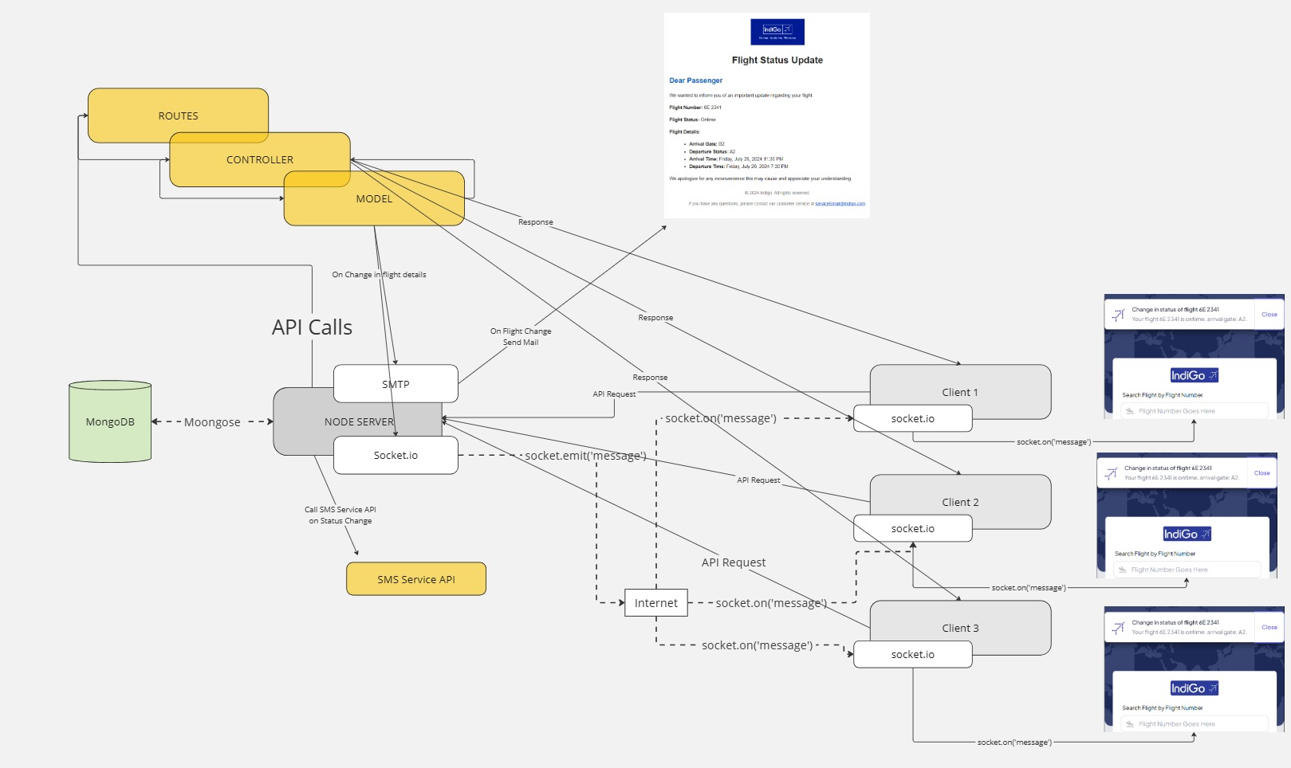
API FLOW from server to client

